Slide 1

DAY 3
Building risk_utils
Organizing, Packaging & Publishing a Real Python Package
Faisal Goussous · August 2026

Slide 2
DAY 3
Welcome Back
YESTERDAY
Fast Python refresher, then modularity & classes
Inheritance & access control
Decorators — @timer, @log_call
Version Control Basics
TODAY
1
Organize risk_utils into a real package
2
Version, install & document it
3
Commit, push, merge to main
4
Project Grading
5
Advanced Topics: Github Actions, CI/CD, Design Patterns
Today we make risk_utils real — not class demos, but code other people will actually import.
BUILDING RISK_UTILS · DAY 3
2

Slide 3

DAY 3
Welcome Back
What’s a better way to welcome you back than with a quiz ☺ ?
On mobile:
Scan the QR Code
OR On your laptop: https://app.sli.do/event/cFJrmPyV7GzZx4FVBgXE3T
Organize risk_utils into a real package
Version, install & document it
Commit, push, merge to main
BUILDING RISK_UTILS · DAY 3
2

Slide 4
MOTIVATION
Why We Package Code
Copy-pasting scripts between courses breaks the moment one course fixes a bug the others still have.
A package installs once, updates once — every course importing risk_utils gets the fix.
Versioning means “which risk_utils am I running?” has a real answer instead of “whichever .py file I happened to grab.”
BUILDING RISK_UTILS · DAY 3
3

Slide 5
MODULE ORGANIZATION
Modules vs. Packages
A module is just a .py file — import validation gives you everything defined in validation.py.
A package is a folder of modules with an __init__.py — it's what makes import risk_utils work at all.
__init__.py can be empty, or it can pick which names show up at the top level of the package.
BUILDING RISK_UTILS · DAY 3
4

Slide 6
MODULE ORGANIZATION
Structuring risk_utils
risk_utils/
__init__.py
models.py # Transaction, BitcoinTransaction
decorators.py # @timer, @log_call
validation.py # schema & outlier checks (provided)
fraud.py # velocity & Benford's checks, SQL (provided)
io.py # bulk-load CSV/Excel into DuckDB (today)
data/ # sample CSV/Excel exports
tests/ # pytest suite
pyproject.toml # packaging metadata (today)
BUILDING RISK_UTILS · DAY 3
5

Slide 7
PACKAGE CREATION
Anatomy of a Package
pyproject.toml is the file that turns a folder of code into something pip can install — name, version, dependencies.
__init__.py marks risk_utils/ as an importable package and controls what from risk_utils import * actually exposes.
Standard layout matters: pip, pytest, and IDEs all expect this shape and get confused when it's missing.
BUILDING RISK_UTILS · DAY 3
6

Slide 8
PRACTICAL 3
Explore risk_utils/
Open risk_utils/ in your Codespace - six files should already be there: __init__.py, models.py, decorators.py, validation.py, fraud.py, external_io.py.
Match each file to what it's for, using the tree on the previous slide: models.py holds Transaction/BitcoinTransaction, decorators.py holds @timer/@log_call, and so on.
Open __init__.py - this is the file that makes `from risk_utils import Transaction` work, instead of the longer `from risk_utils.models import Transaction`.
CHALLENGE
Pick one file and explain to a partner what it's for.
BUILDING RISK_UTILS · DAY 3
7

Slide 9
PACKAGE CREATION
Writing pyproject.toml
[project]
name = "risk_utils"
version = "0.1.0"
description = "Shared risk-analysis utilities for the training program"
requires-python = ">=3.10"
dependencies = [
"pandas",
"duckdb",
]
[build-system]
requires = ["setuptools"]
build-backend = "setuptools.build_meta"
BUILDING RISK_UTILS · DAY 3
8

Slide 10
SEMANTIC VERSIONING
What & Why
MAJOR.MINOR.PATCH — e.g. 1.4.2. Each number means something specific, and other code can depend on that meaning.
PATCH: bug fix, nothing changes for callers. MINOR: new feature, old code still works. MAJOR: something breaks.
This matters here specifically because future cohorts will pip install risk_utils — a careless bump breaks someone else's class.
BUILDING RISK_UTILS · DAY 3
9

Slide 11
SEMANTIC VERSIONING
Practice
You fix a typo in an error message inside check_positive_amount.
0.1.0 → ? (0.1.1 — PATCH)
You add a new function to validation.py, and everything else still works.
0.1.1 → ? (0.2.0 — MINOR)
You rename flag_velocity to flag_risk_velocity, breaking every import that used the old name.
0.2.0 → ? (1.0.0 — MAJOR)
BUILDING RISK_UTILS · DAY 3
10

Slide 12
PRACTICAL 5
Read pyproject.toml
# pyproject.toml
[project]
name = "risk_utils"
version = "0.1.0"
description = "Shared risk-analysis utilities for the training program"
requires-python = ">=3.10"
dependencies = ["pandas", "duckdb"]
CHALLENGE
Find the line that sets the minimum Python version, and the line you'd edit to add a new dependency.
BUILDING RISK_UTILS · DAY 3
11

Slide 13
INSTALLING YOUR PACKAGE
pip install -e .
cd risk_utils/
pip install -e .
# -e = "editable" install: pip links to this folder instead of
# copying it, so source edits take effect immediately -
# no reinstall needed after every change
python -c "from risk_utils import Transaction; print(Transaction)"
BUILDING RISK_UTILS · DAY 3
12

Slide 14
PRACTICAL 6
Install & Verify
BUILDING RISK_UTILS · DAY 3
pip install -e .
python
>>> from risk_utils import check_positive_amount
>>> check_positive_amount(15000)
True
CHALLENGE
Close and reopen your terminal, then import risk_utils again without reinstalling — confirm it still works. Once confirmed, commit and push any changes, same as before.
BUILDING RISK_UTILS · DAY 3
13

Slide 15
DOCUMENTATION
Docstrings & README
def check_positive_amount(amount):
"""
Raise if amount is not a positive number.
Args:
amount (float): transaction amount_paid.
Returns:
bool: True if positive; raises ValueError otherwise.
"""
if amount <= 0:
raise ValueError(f"amount_paid must be positive, got {amount}")
return True
# README.md answers: what is this for, and how do I use it?
BUILDING RISK_UTILS · DAY 3
14

Slide 16
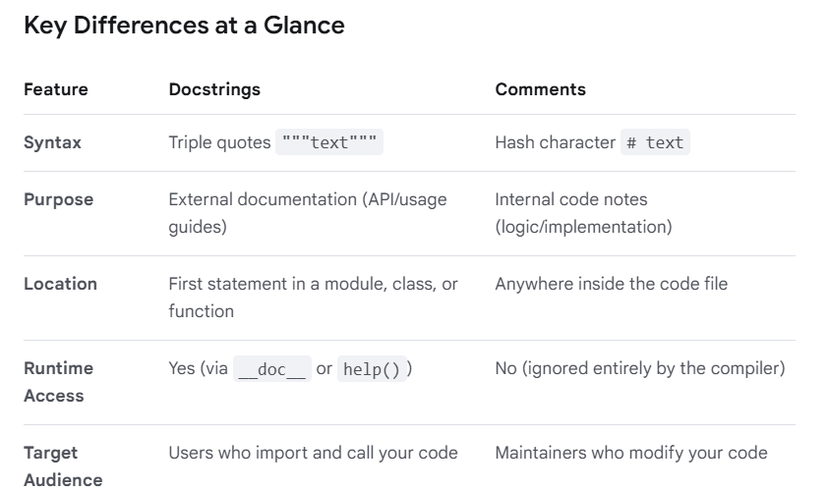
DOCUMENTATION
Docstrings vs Code Comments
BUILDING RISK_UTILS · DAY 3
14

Slide 17
PRACTICAL 7
Read the Docs
Open validation.py and read the docstring on zscore_tag - it explains a real statistical limitation, not just what the function does.
Open the README.md at the repo root - it's the same one a future student reads before running pip install.
Docstrings and READMEs are the same idea as a code comment, aimed at someone who never watched you write the code.
CHALLENGE
Read the docstring for zscore_tag in validation.py - why would it fail to flag an outlier in a batch of only 5 transactions?
BUILDING RISK_UTILS · DAY 3
15

Slide 18
MERGING TO MAIN
Why Review Matters
Your own scratch script only has to make sense to you. risk_utils has to make sense to everyone who imports it.
A second set of eyes catches the missing null check, the copy-pasted docstring, the version bump nobody remembered.
Review before merge is the last checkpoint before “it works on my machine” becomes “a dependency for three other courses.”
BUILDING RISK_UTILS · DAY 3
20

Slide 19
BONUS
def test_check_required_fields():
txn = {"Account": "A1", "Amount_Paid": 100, "Timestamp": "2024-01-01"}
assert check_required_fields(txn) is True
def test_check_positive_amount_raises():
try:
check_positive_amount(-100)
assert False, "should have raised"
except ValueError:
pass
test_check_required_fields()
test_check_positive_amount_raises()
print("all tests passed")
Testing Basics
BUILDING RISK_UTILS · DAY 3
16

Slide 20
BONUS
Testing Basics
def test_check_required_fields():
txn = {"Account": "A1", "Amount_Paid": 100, "Timestamp": "2024-01-01"}
assert check_required_fields(txn) is True
def test_check_positive_amount_raises():
try:
check_positive_amount(-100)
assert False, "should have raised"
except ValueError:
pass
test_check_required_fields()
test_check_positive_amount_raises()
print("all tests passed")
BUILDING RISK_UTILS · DAY 3
16

Slide 21
BONUS: CI/CD
Run the Test Suite
BUILDING RISK_UTILS · DAY 3
pip install -e ".[dev]"
pytest
# or, without installing the dev extra:
python tests/run_all_tests.py
# ============ 31 passed in 0.42s ============
CHALLENGE
Run the suite yourself - all 31 tests across test_models.py, test_validation.py, test_fraud.py, and test_io.py should pass.
BUILDING RISK_UTILS · DAY 3
27

Slide 22
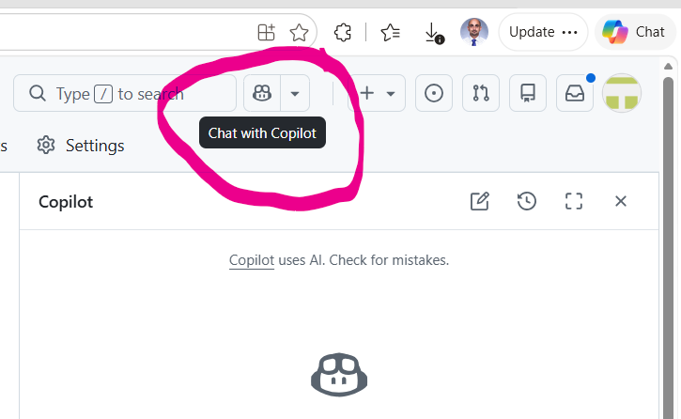
BONUS: CI/CD
Practical: Testing
CHALLENGE
1- Open the file FinalPackage/Tests/Test_Valiation.py and Ask GitHub copilot to explain the function def test_check_positive_amount_raises_on_negative()
2- Add a test for zero amounts
3- Run the test suite
BUILDING RISK_UTILS · DAY 3
27

Slide 23
BONUS: CI/CD
Why Tests & CI/CD Matter
Tests catch regressions automatically — code that worked in your manual demo can silently break when someone edits it six months later.
Continuous Integration (CI) runs your test suite automatically on every push, so nobody has to remember to run it by hand.
Continuous Deployment automatically builds the package after every passing code change and deploys it straight to live users without human intervention.
BUILDING RISK_UTILS · DAY 3
26

Slide 24
BONUS: CI/CD
Introducing GitHub Actions
GitHub Actions runs commands automatically in response to repo events — like “every push” or “every pull request.”
A workflow file (.github/workflows/tests.yml) tells GitHub Actions what to run: install dependencies, then run pytest.
If any test fails, GitHub marks the check as failed — a branch protection rule can then block the merge until it's fixed.
BUILDING RISK_UTILS · DAY 3
28

Slide 25
BONUS: CI/CD
A Minimal Workflow File
name: tests
on: [push, pull_request]
jobs:
test:
runs-on: ubuntu-latest
steps:
- uses: actions/checkout@v4
- uses: actions/setup-python@v5
with:
python-version: "3.11"
- run: pip install -e ".[dev]"
- run: pytest
# every push and every PR triggers this - a red X blocks the merge
BUILDING RISK_UTILS · DAY 3
29

Slide 26
RISK_UTILS V1.0
What We Built
models.py — Transaction, BitcoinTransaction (Day 2)
decorators.py — @timer, @log_call (Day 2)
validation.py — schema checks, null checks, Z-score outlier tagging (provided)
Organized with Git & GitHub — branched, committed, pushed, and merged to main (today)
fraud.py — velocity checks, Benford's Law, run as SQL (provided)
io.py — bulk-loads CSV/Excel folders into a local DuckDB database
Packaged, versioned (0.1.0), documented, installable with pip install -e .
Next up — future cohorts install risk_utils instead of starting from scratch.
BUILDING RISK_UTILS · DAY 3
22

Slide 27
LOOKING AHEAD
Reusing risk_utils in Future Courses
A future cohort doesn't relive Day 1-3 — they pip install risk_utils and start from working code.
Every bug fixed here, every function documented here, is a bug that cohort never hits and a function they don't have to guess about.
That's the actual payoff of today's packaging work: it outlives this room.
BUILDING RISK_UTILS · DAY 3
23

Slide 28
COURSE RECAP
The Full Arc
Day 1 — SQL Essentials: querying and joining the AML dataset directly in DuckDB.
Day 2 — Python Essentials: refresher, then classes, decorators, and design patterns, building the first risk_utils code.
Day 3 — Building risk_utils: organized, Git & GitHub workflow, versioned, documented, and published as a real package.
BUILDING RISK_UTILS · DAY 3
24

Slide 29
Thank You
Questions?
risk_utils v0.1.0 — pip install -e . and it's yours.
BUILDING RISK_UTILS · DAY 3
25

Slide 30
MERGING TO MAIN
When Branches Disagree
<<<<<<< HEAD
def flag_velocity(con, max_count=5):
=======
def flag_velocity(con, max_count=10):
>>>>>>> your-branch-name
# git couldn't tell which version you want - that's a merge conflict.
# pick the right lines, delete the <<<< ==== >>>> markers, then:
git add risk_utils/fraud.py
git commit -m "Resolve merge conflict in flag_velocity"
BUILDING RISK_UTILS · DAY 3
19

Slide 31
DESIGN PATTERNS
Design Patterns: What & Why
A design pattern is a reusable, proven solution to a common design problem — not code to copy-paste, but a template you adapt.
For each pattern below: we'll look at a problem first, feel the pain of maintaining or extending that code, then see how the pattern solves it.
Patterns are usually grouped by what they do: creational (object creation), structural (composing objects), behavioral (object interaction).
BUILDING RISK_UTILS · DAY 3
30

Slide 32
DESIGN PATTERNS
Singleton — The Problem
Some things should exist exactly once across a whole program — a shared config, a single database connection. Plain classes don't guarantee that.
config1 = AppConfig()
config1.threshold = 10000
config2 = AppConfig() # oops -- a totally separate instance
print(config2.threshold) # not 10000 -- inconsistent state
Two "configs" that quietly disagree with each other is a real and painful bug to track down.
BUILDING RISK_UTILS · DAY 3
31

Slide 33
DESIGN PATTERNS
Singleton — The Pattern
Guarantee exactly one instance ever gets created — every call just hands back the same object. singleton() runs once per decorated class, so instance lives safely in that class's own closure via nonlocal — no shared dict or list required.
Better implementations exist (thread-safe, subclass-aware) — we're using this simpler version here given time constraints.
def singleton(cls):
instance = None
def get_instance(*args, **kwargs):
nonlocal instance
if instance is None:
instance = cls(*args, **kwargs)
return instance
return get_instance
@singleton
class AppConfig:
def __init__(self):
self.threshold = 10000
config1 = AppConfig()
config2 = AppConfig()
config1 is config2 # True -- the same object
BUILDING RISK_UTILS · DAY 3
32

Slide 34
DESIGN PATTERNS
Factory — The Problem
Object-creation logic scattered across the codebase — if/elif blocks copy-pasted everywhere an alert gets built.
if currency.lower() == "bitcoin":
txn = BitcoinTransaction(account_number, amount, currency, is_laundering)
else:
txn = Transaction(account_number, amount, currency, is_laundering)
# ...and the same if/else, copy-pasted, in four other files
Add a new alert type, and now you're hunting down every copy of this logic to update it.
BUILDING RISK_UTILS · DAY 3
33

Slide 35
DESIGN PATTERNS
Factory — The Pattern
One function owns the decision of which class to build. Callers just ask for what they need.
def transaction_factory(account_number, amount, currency, is_laundering):
if currency.lower() == "bitcoin":
return BitcoinTransaction(account_number, amount, currency, is_laundering)
return Transaction(account_number, amount, currency, is_laundering)
txn = transaction_factory("834A31900", 1, "Bitcoin", 1)
BUILDING RISK_UTILS · DAY 3
34

Slide 36
DESIGN PATTERNS
Observer — The Problem
Every place that flags an alert lists the same reactions by hand. They're not calling one shared function — each one independently repeats the list.
def flag_large_transaction(txn):
t = Transaction(**txn)
send_email(t)
write_to_log(t)
update_dashboard(t)
def flag_laundering_transaction(txn):
t = Transaction(**txn)
send_email(t)
write_to_log(t)
update_dashboard(t)
# ...and 3 more "flag_*" functions elsewhere, each with its own copy of this list
Add a new reaction (say, a Slack alert)? You have to find and update every one of these functions separately.
BUILDING RISK_UTILS · DAY 3
35

Slide 37
DESIGN PATTERNS
Observer — The Pattern
Subscribers register once; the publisher notifies all of them automatically whenever something happens.
class AlertPublisher:
def __init__(self):
self._subscribers = []
def subscribe(self, fn):
self._subscribers.append(fn)
def notify(self, alert):
for fn in self._subscribers:
fn(alert)
publisher = AlertPublisher()
publisher.subscribe(send_email)
publisher.subscribe(write_to_log)
publisher.notify(alert) # every subscriber runs, automatically
BUILDING RISK_UTILS · DAY 3
36

Slide 38
DESIGN PATTERNS
Beyond These Three
Singleton, Factory, and Observer are 3 of roughly 23 classic patterns. Worth knowing the names, even before you know the details:
CREATIONAL
STRUCTURAL
BEHAVIORAL
Builder
Prototype
Abstract Factory
Adapter
Decorator (the pattern)
Facade
Proxy
Composite
Bridge
Flyweight
Strategy
Command
State
Template Method
Iterator
Mediator
Memento
Chain of Responsibility
Visitor
Interpreter
You won't need all 23 for risk_utils — but recognizing the name and the shape of the problem it solves will save you real time later.
BUILDING RISK_UTILS · DAY 3
37

